Slide 1
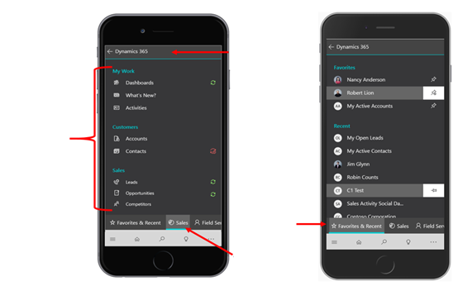
Switch apps
List of records in the selected work area
Quick access to favorite and recent records
Change work area

